Slide 1

The Effects of Airport Traffic on the
Transmission of COVID-19
Pelumi Ajayi, Heather Seo, Qiyu Wang

Slide 2




Meet the Team
Pelumi Ajayi
H. Donghwa Seo
Qiyu Wang

Slide 3




Presentation Overview
Analysis
Findings Insights
Background
Limitations

Slide 4
Background and Preparations

Slide 5

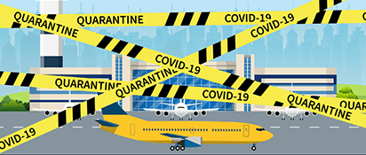
Project Goal
COVID-19 transformed our lives
We want to know
how airport traffic has contributed to transmission of COVID-19
policy recommendation for border control
Notes:
Goal: We want to study how the international connections through airlines correlated with the diffusion of pandemic. and therefore come up with policy recommendations for the executive branches of the governments.
We measure valunability of each state/province by the percentage of changes for the average cases for each period of 5 days againsting the last period.

Slide 6
Datasets and Variables
Confirmed cases:
Travel:
Demographic:
Economic:
daily confirmed COVID-19 cases
Airline route
Airline traffic
number of 2019 visitors
population density, km²
sex ratio
median age
Gini Index
GDP
unemployment rate
life expectancy
number of ICU beds
number of hospitals and efficiency measures
lockdown policy implementation date
degree of lockdown
Medical:
Policy:

Slide 7
Datasets and Variables
16 US States
California, Colorado, Florida, Georgia, Hawaii, Illinois, Massachusetts, Michigan, North Carolina, New Jersey, Nevada, New York, Texas, Virginia, Washington

Slide 8
Background
6 Canada States
West: British Columbia, Alberta,
Mid: Manitoba, Ontario
East: Quebec, Nova Scotia

Slide 9
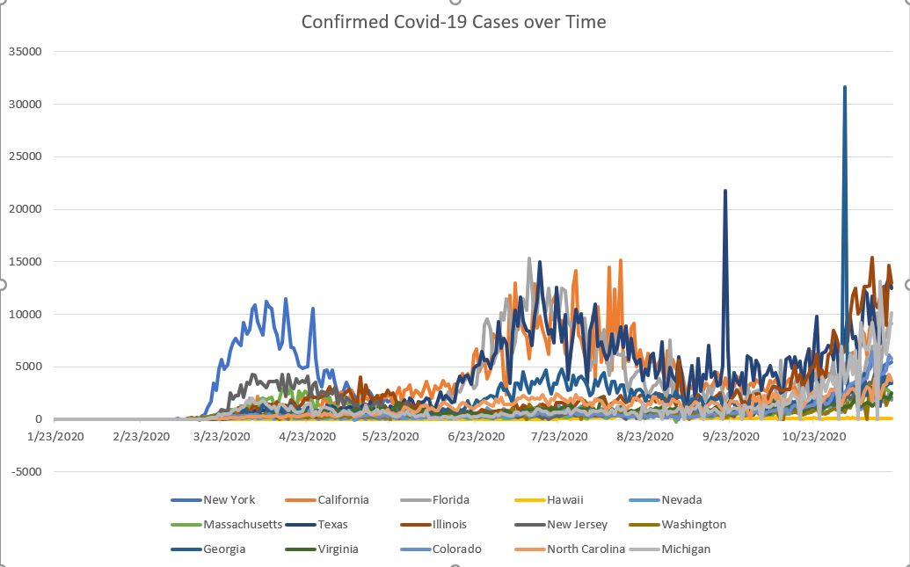
Datasets and Variables

Slide 10
Exploratory
Analysis

Slide 11
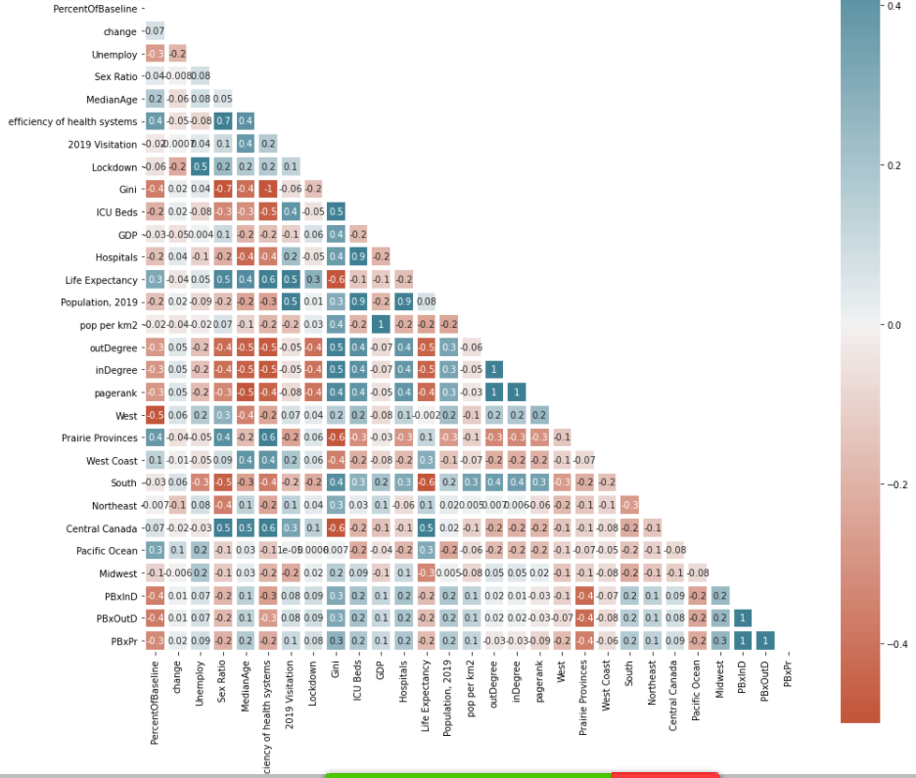
Centrality Relationships with other Variables
Variables with Strong Correlation with PageRank:
Negative Relationships:
Median Age
Sex Ratio - Male to Female
Lockdown
Positive Relationships:
Gini - “measure of statistical dispersion intended to represent the income inequality or wealth inequality within a nation or any other group of people”
ICU Beds
Hospitals
PageRank is collinear with about 70% of the variables we analyzed. This means there is an interaction effect between PageRank and other variables. So as other variables change PageRank changes which change the percent of confirmed cases
Notes:
AS median age goes down higher pagerank because younger people are more likely to travel so indegree increases

Slide 12
Assumptions between Collinear Variables
Finding & Assumption
Although we saw significant correlation between PageRank and other variables we acknowledge that this may be due to our limited scope.
For example, US cities might all have high GINI scores, and at the same time it can have a lot more visitations than Canadian cities. So this correlation might or might not be applicable to other countries.
Second Assumption
Some of the correlations discovered make logical sense.
For example, countries that’s richer might also have more ICU beds, higher tourism rates which is correlated with PageRank according our heatmap.
Some looks suspicious, such as sex ratio.
Notes:
Although we saw significant correlation between PageRank and other variables we acknowledge that it may be because we only using data from US and Canada, where those countries have certain characteristics.
However, for some of other correlations, such as ICU beds, it makes more sense. The countries that’s richer might have more ICUs, and also more tourism which is correlated with pagerank according to the heatmap.
It also happens to some of others such as hospital, populations median age too (there is a negative relationship between median age and pagerank as age increases pagerank decreases).

Slide 13
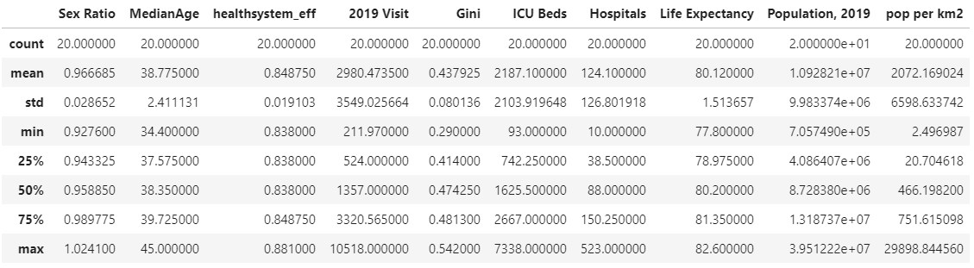
Centrality Relationships with other Variables

Slide 14

Insights

Slide 15
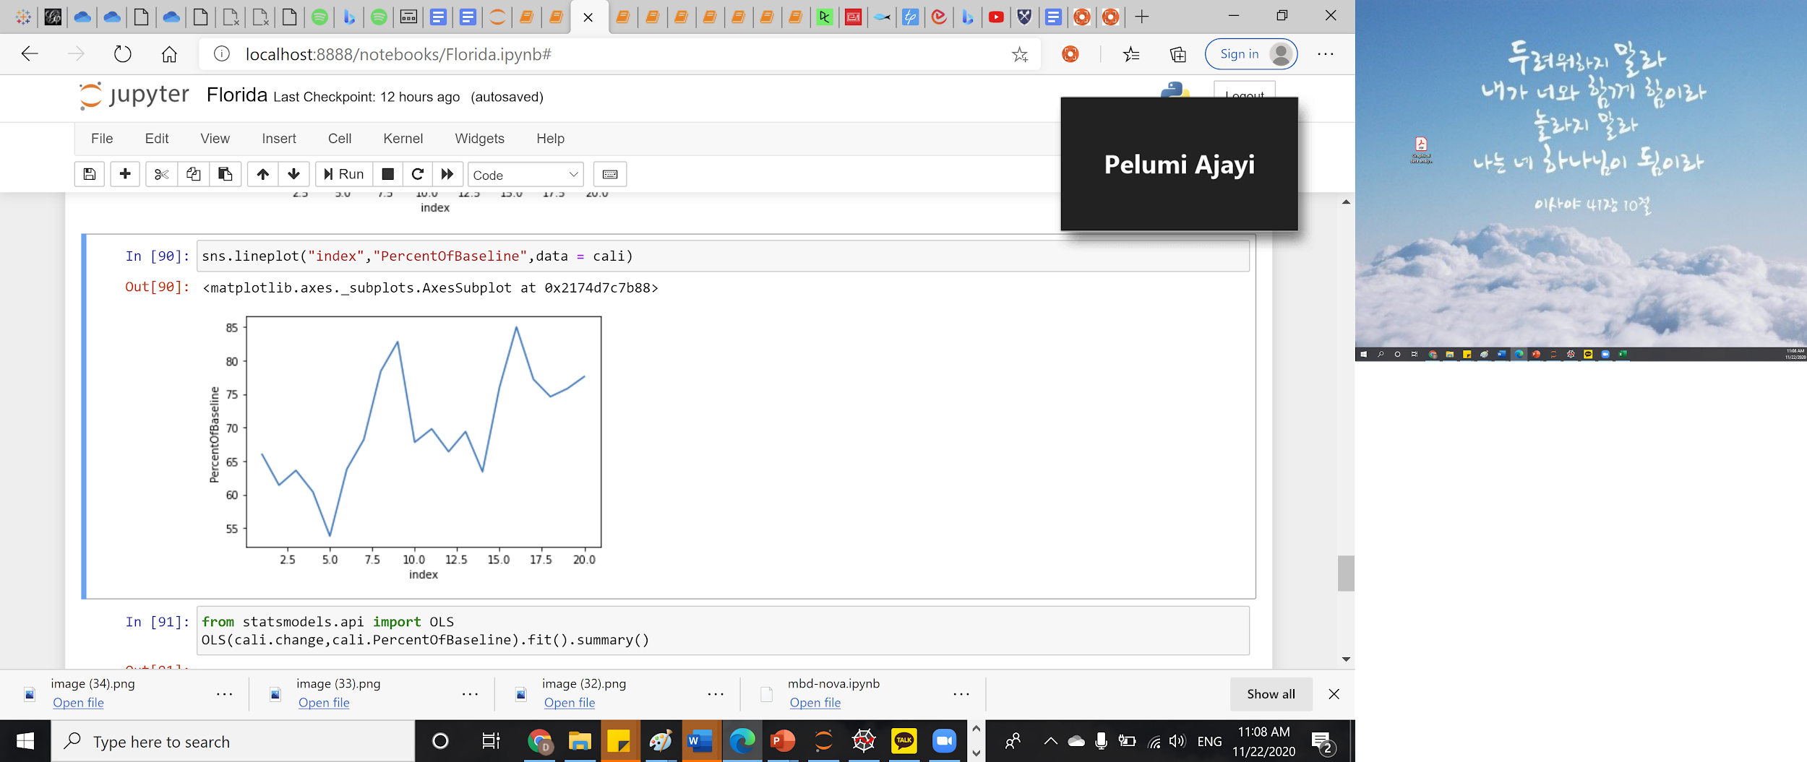
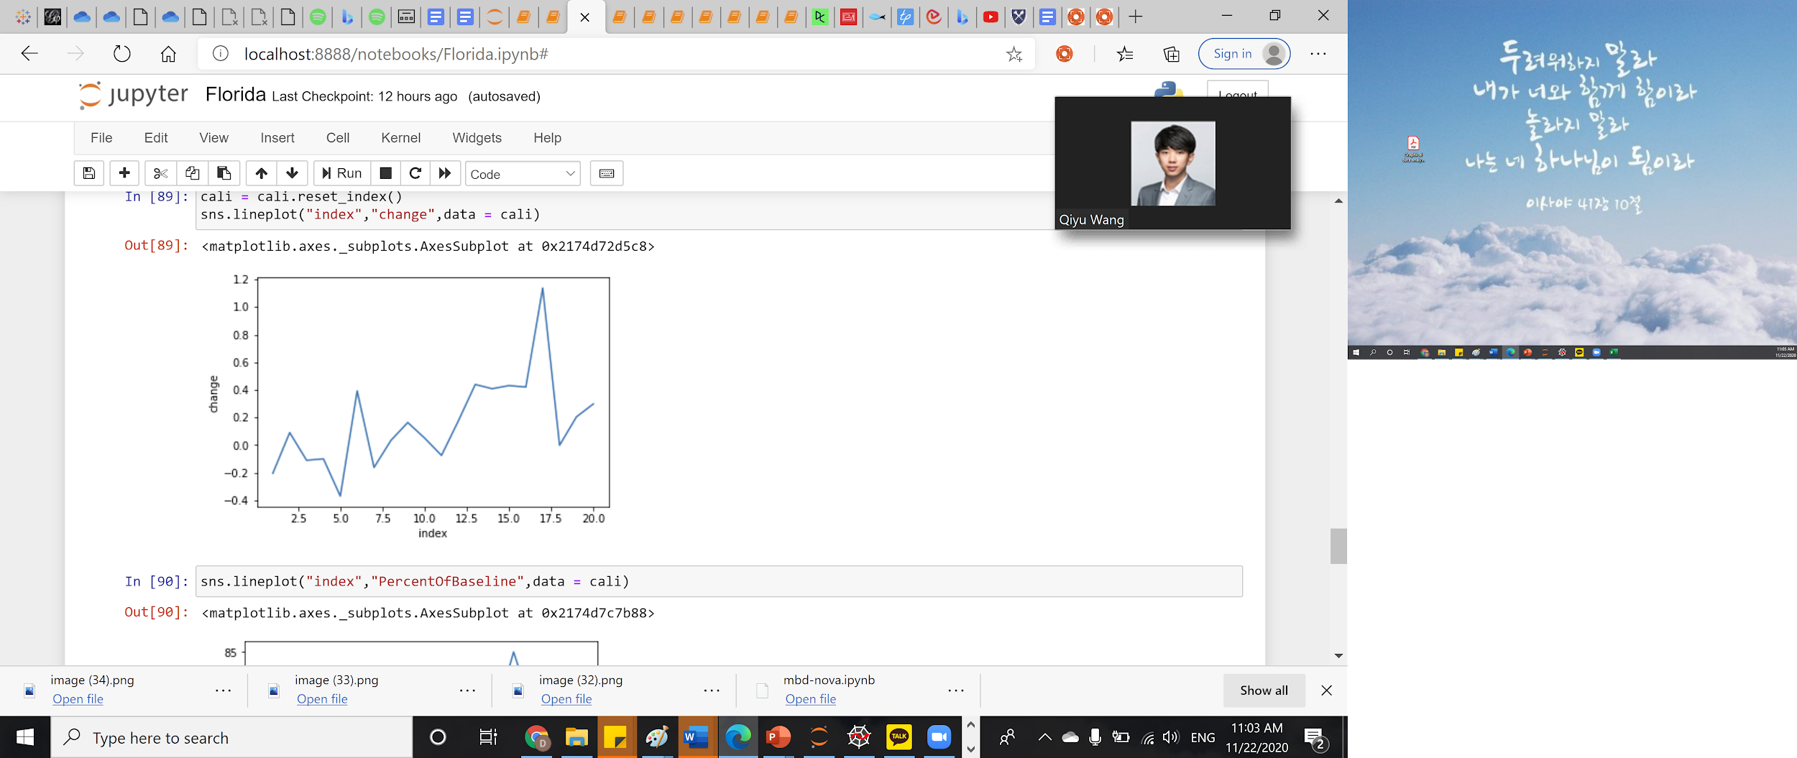
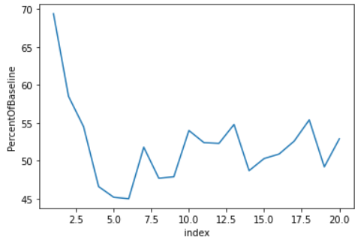
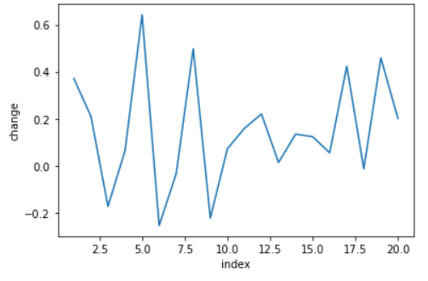
There are synchronized changes between percent of operating airplanes and the number of covid cases
Model 1 Findings
The patterns match in the individual states level
Florida
Florida
California
California

Slide 16
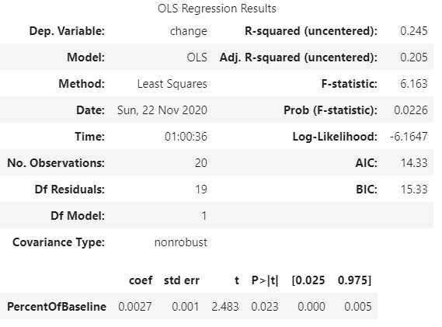
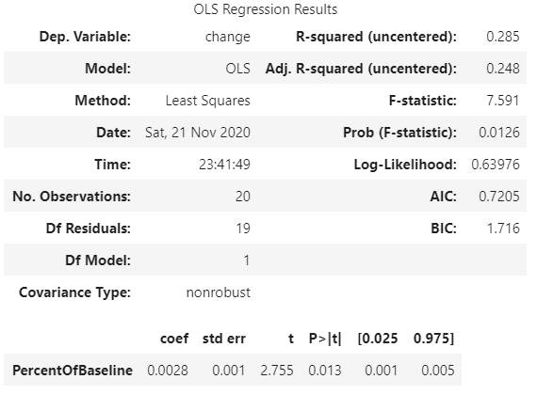
There are synchronized changes between percent of operating airplanes and the number of covid cases
Model 1 Findings
Florida
California

Slide 17
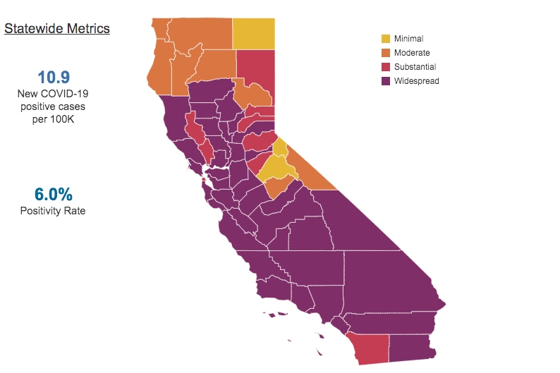
Model 1 Findings
Model 1: Air Traffic and COVID-19 Cases
We found statistically significant relationship between percentage change in confirmed cases.
.3% positive relationship between air traffic and covid.
E.g. California:
Every percentage increase in the percentage of operating fights will cause an increase of 0.3%. Considering the population base of California of 39.5 millions, each percent increase of operating fights could possibly cause 118500 confirmed cases.
Notes:
the first model we built only used one variable which was the airtraffic data for individual states , and we saw some statistically significant relationship between percentage change in confirmed cases. the first model we built only used one variable which was the airtraffic data for individual states , and we saw some statistically significant relationship between percentage change in confirmed cases.

Slide 18
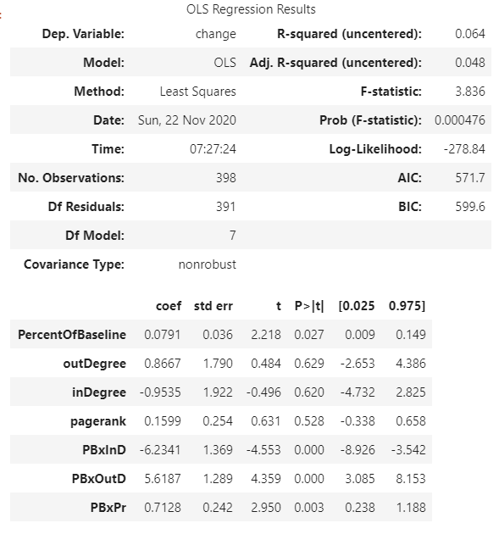
Aggregate level:
not as informative as the previous models
Assumption 1: The huge drop in the r-squared may be because this data is not time series
Assumption 2: As we are encountering different states and countries there are more factors affecting the confirmed cases, such as the local policies, and people’s awareness of COVID
Model 2 Findings

Slide 19
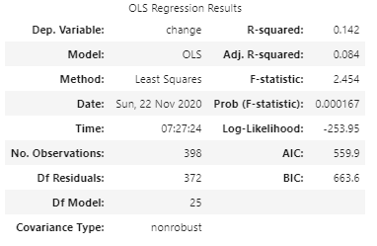
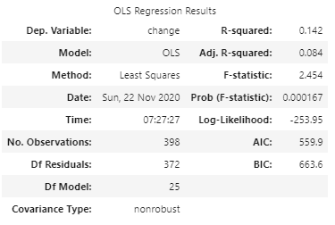
The new features: too much multicollinearity, not much information
Model 3 Findings
Linear model
Ridge Regression
Notes:
For the third model we included more factors to make better prediction but there were a lot collinearity between the variables showing that it didn’t add additional information to the model.

Slide 20
Limitations

Slide 21
Limitations
the quality of the dataset, which could bring better fit and predictions
the volume of data, which will open more techniques available to us, such as Spark ML and Random Forest

Slide 22
Recommendation

Slide 23
Should states enforce border control regulations ?
Recommendation
Based on the results, we clearly see a correlation between confirmed cases and international airline connections, and based on this information government officials should be able to determine in areas where applicable to impose lockdown/quarantine to address the increasing rate of covid cases, especially for places that has relatively high indegree/pagerank centrality.

Slide 24
Thank you!
Questions?

